Slide 1
HELIX: Holistic Optimization for Accelerating Iterative Machine Learning
Doris Xin, Stephen Macke, Litian Ma, Jialin Liu, Shuchen Song, Aditya Parameswaran University of Illinois (UIUC)

Slide 2






Machine Learning is Everywhere!
Machine learning development
is inherently iterative
Notes:
Machine learning is everywhere,
and developing a machine learning application is an
inherently iterative process.
What do we mean by this? Let’s take a look at an example

Slide 3


Application: Census Income
age | education | gender | occupation | …
20 | HS | M | student
60 | BA | F | craft-repair
40 | MS | F | sales
Notes:
In this example application, your objective is to use anonymized demographic information to predict income.

Slide 4
W₀
data.csv
Data
Preprocessing
age
edu.
gender
occ.
Logistic Regression
Modeling
Predictions
Evaluation
Accuracy
Notes:
You might start with a workflow that looks like this.
For data preprocessing, you make features using four named columns from the CSV.
Then for modeling, you use these features to train a logistic regression model, and use the trained model to make predictions.
Finally we evaluate model performance on some ground truth labels.
If you don’t have any, you might want to check out Snuba.

Slide 5

W₀
W₁
W₂
SVM
AUC
2hrs
2hrs
2hrs
Notes:
You run this workflow.
It took 2 hours, and you got some results back, and you think they can be improved.
[click] So you change the model from logistic regression to SVM. It took another 2 hours to run, and you get updated results.
[click] Now you’re interested in looking also at the AUC instead of accuracy, and computing this new metric took another 2 hours.

Slide 6

Improvement via Iteration
Knobs to tune
  Data preprocessing: e.g., data cleaning, adding features
  Modeling: e.g., hyperparameters, model type
  Post processing: e.g., evaluation metrics
  Can take hundreds of iterations!
Currently rerun workflow end-to-end in every iteration
  1st iter: 2 hrs → 2nd iter: 2 hrs → 3rd iter: 2 hrs
Materialize intermediate results to speed up subsequent executions through reuse
W A S T E F U L
Notes:
[click] As we can see from the example, there are many knobs in a workflow that can be tuned to improve performance.
You could change data preprocessing by adding or removing features
You can tune model hyperparameters and change model types
After obtaining a model, you could also do things like computing different metrics to help with analysis.
This can take hundreds of iterations because you might not get lucky with every iteration, and it’s hard to predict what will happen without running it.
[click] Using the current development stack, the default behavior is to rerun the entire workflow end-to-end in every iteration,
regardless of what actually changed.
In our example, the first iteration took 2 hours, the second took 2 hours even though we only changed the model,
and the 3rd took another 2 hours when we only changed the last operator.
[click] This is incredibly wasteful and really slows down the development cycle.
[click] The eureka moment was when we realized that we could fix this by materializing intermediate results to speed up future iterations through reuse.

Slide 7






2hrs
30min
5min
Notes:
Now, instead of what we had earlier,
changing the model only takes 30minutes to rerun because we are reusing the data preprocessing results,
and changing the metric only takes 5 minutes because we are reusing most of the workflow.
This makes your developers happy, your AWS bill happy, and even the environment happy because you’re reducing your carbon footprint by eliminating redundant compute cycles
This is a no-brainer. We should totally do it!
As we sat down and thought about how to do this automatically, we encountered a couple challenges.

Slide 8

What to materialize?
Notes:
The first challenge is figuring out what to materialize.
[click] Suppose we knew we’re changing the last node,
[click] materializing the one above would be really useful.
[click] But suppose instead we changed this purple node.
Now everything downstream to the changed node has to be recomputed,
[click] and our materialized results just became useless.
[click] So we need to somehow be cognizant of the future when making decisions.
How do we do this without the ability to see into the future?
Is there a way to get around this problem?
Those are the questions we need to answer for this problem.

Slide 9
What to reuse?
Suppose everything was materialized
Reload input to changed nodes?
Notes:
The second challenge is choosing what to reuse.
Suppose that we’ve materialized everything from the previous iteration.
[click] Let’s say we changed this node.
[click] The simplest thing to do is to reload the input node.
[click] but remember, our objective is to minimize overall runtime.
[click] If loading the input node is some insanely expensive operation,
[click] we might be better off reloading an upstream node and recomputing a portion of the reusable graph.
So there’s no hard and fast rules for how to reuse optimally.
It all depends on your workflow.

Slide 10
Recap
ML is iterative
  Data preprocessing (e.g. add features)
  Modeling (e.g. hyperparameter)
  Post processing (e.g. evaluation metric)
Materialize and reuse! Need to
  Materialize to handle future changes
  Reuse optimally to minimize overall runtime
more reuse
.
Notes:
To quickly recap.
[click] Machine learning development is iterative,
and the types of iterations are data preprocessing, modeling, and post processing.
[click] As the change happens further down in the workflow graph, we have more opportunities for reuse.
[click] Materializing intermediate results and reusing them across iterations can help speed things up.
But to operationalize it, we need to think about two things:
[click] how to materialize intelligently so we can actually reuse effectively in the future
[click] how to reuse optimally to minimize overall runtime for the workflow

Slide 11

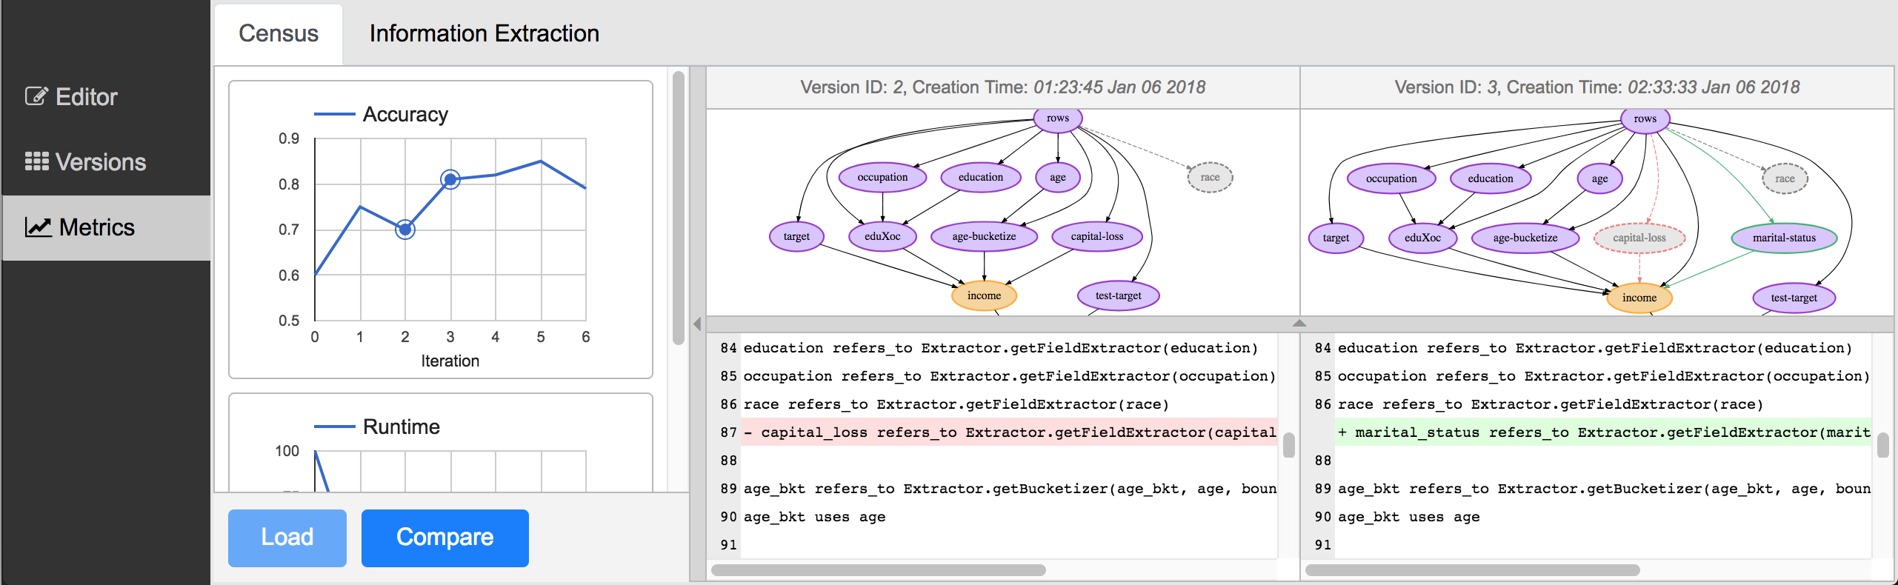
VLDB ‘18 Demo
Notes:
All of this motivated our design and development of Helix,
which is a declarative machine learning platform targeted at accelerating iterative development
by automating materialization and reuse across iterations.
It also has an IDE that makes suggestions for iterations and helps developers track changes,
which was demonstrated at VLDB '18 last year
We focus on the materialization and reuse problem for the rest of this talk.

Slide 12

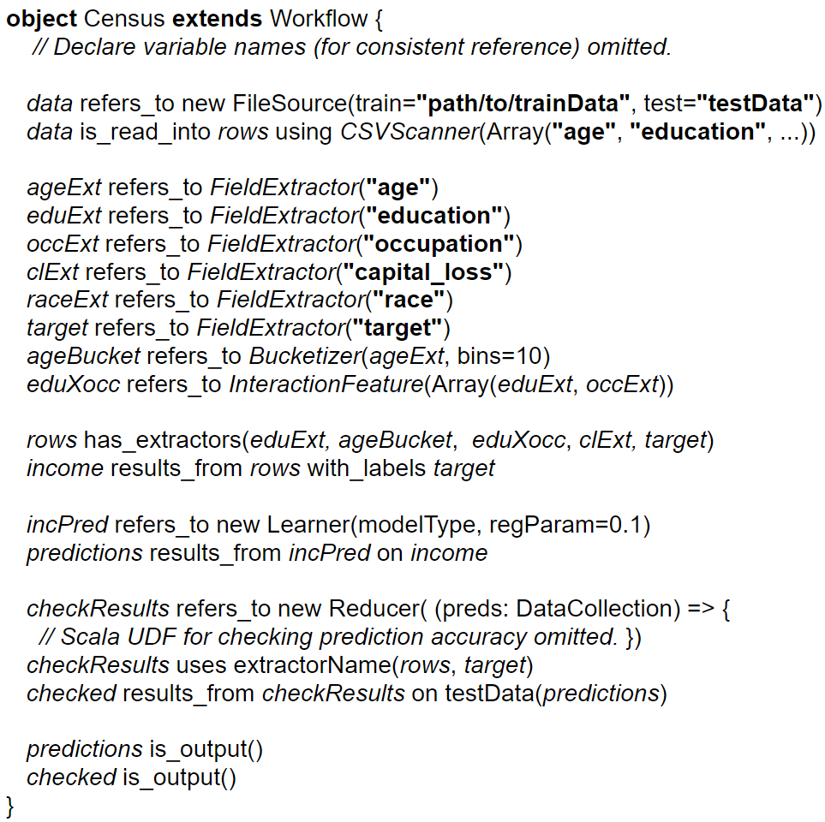
The Workflow Lifecycle
Compile Time
Run Time
Reuse
Optimizer
Materialization
Optimizer
Notes:
This is how we think about the workflow lifecycle in Helix.
Users start by writing their end-to-end workflow in our DSL.
You can find out more about the DSL in section 3 of the paper.
The program is compiled into a DAG of operators,
and we use this DAG to make reuse decisions at compile time,
starting in the 2nd iteration.
The optimized DAG is then sent to the executor,
and we make materialization decisions the workflow runs,
starting in the first iteration.
Modeling the workflow in this way lets us decompose the redundancy removal problem into two optimization problems.

Slide 13
The Workflow Lifecycle
Compile Time
Run Time
Reuse
Optimizer
Materialization
Optimizer
Notes:
Let’s first talk about the reuse problem

Slide 14
Reuse: Optimal Execution Plan
n₂
Compute
n₁
n₃
s
Load
n₄
n₅
Prune
n₆
n₇
n₈
s.t.
or
Notes:
The setup is pretty simple.
You have your workflow.
[click] For each node, you want to assign it one of three states,
compute, which means to compute the node from inputs,
load, which means to load previously materialized results given that they are still valid,
and prune, which means to skip the node entirely.
[click] The only constraint for the state assignments is that for a compute node, its parents must be in the compute or load state.
In other words, the inputs to a compute node cannot be pruned.

Slide 15
Reuse: Optimal Execution Plan
n₂
Compute
Bad!
n₁
n₃
s
Load
n₄
n₅
Prune
n₆
n₇
n₈
s.t.
or
Notes:
Just to see if everyone’s still awake.
Is this a legal assignment?
[click] No, this is bad because n6, which is in the compute state, has a parent in the prune state.

Slide 16
Reuse: Optimal Execution Plan
n₂
Compute
n₁
n₃
s
Load
n₄
n₅
Prune
n₆
n₇
n₈
s.t.
or
Total cost = load time for ’s +
compute time for ’s
Notes:
We can fix this by switching n3 to load, and we satisfy our constraint.
[click] The cost to run this plan is the cost to load all the red nodes plus the cost to compute all the blue nodes from inputs.
Great. How do we come up with the optimal plan to minimize this cost?

Slide 17
Reuse: Optimal Execution Plan
n₂
MinCut
n₁
n₃
n₄
n₅
n₆
n₇
n₈
Notes:
Turns out this problem is an application of MinCut!
At a high level, the mincut we obtain indicates the frontier of reuse.

Slide 18
Reuse: Optimal Execution Plan
n₂
MinCut
n₁
n₃
n₄
n₅
n₆
n₇
n₈
Notes:
That means everything below the mincut should be assigned the compute state.

Slide 19
Reuse: Optimal Execution Plan
n₂
MinCut
n₁
n₃
n₄
n₅
n₆
n₇
n₈
Notes:
and everything right above the mincut should be assigned the load state.

Slide 20
Reuse: Optimal Execution Plan
n₂
MinCut
n₁
n₃
n₄
n₅
n₆
n₇
n₈
Guaranteed to have the lowest cost
Proof in Technical Report at https://arxiv.org/pdf/1812.05762.pdf
Notes:
This allows us to prune away all ancestors to the red nodes.
[click] The cost of this plan is guaranteed to be the lowest.
The proof for this is a bit long and can be found in the technical report.
One side note here.
To make sure we reuse only things that are actually unchanged across iterations,
we set the cost of non-reusable nodes to infinity so that they wouldn’t be part of an optimal solution.

Slide 21
The Workflow Lifecycle
Compile Time
Run Time
Reuse
Optimizer
Materialization
Optimizer
Notes:
So that’s how reuse happens.
Now let’s take a look at the materialization problem.

Slide 22
Optimal Materialization Plan
n₀
n₀
n₄
n₃
n₅
n₂
Total cost =
n₂
n₁
n₃
n₁
n₃
Mat. cost +
n₄
n₅
n₄
n₅
W_{t}
n₆
W_{t+1}
n’₆
n₇
n₈
n₇
n₈
Notes:
[click] So remember we said that predicting the future is hard?
[click] well let’s punt on that for a second and assume we know the next iteration,
where everything stayed the same except n6.
There are two parts to the optimization objective.
[click] First, at time t, you want to pick a subset of nodes to write to disk.
[click] which incurs a materialization cost.

Slide 23
Optimal Materialization Plan
n₀
n₀
n₄
n₃
n₅
n₂
Total cost =
n₂
n₁
n₃
n₁
n₃
Mat. cost +
n₄
n₅
n₄
n₅
W_{t}
n₆
W_{t+1}
n₆
n₇
n₈
n₇
n₈
Notes:
Then in the next iteration,
[click] you reload the nodes that were just materialized,

Slide 24
Optimal Materialization Plan
n₀
n₀
n₄
n₃
n₅
n₂
Total cost =
n₂
n₁
n₃
n₁
n₃
Mat. cost +
n₄
n₅
n₄
n₅
Optimal runtime
from reuse
W_{t}
n₆
W_{t+1}
n₆
n₇
n₈
n₇
n₈
Notes:
to save some compute time by pruning away portions of the graph.
And the run time from the optimal reuse plan in the next iteration contributes the second part of the cost.

Slide 25
Optimal Materialization Plan
Total cost = mat. cost + reduced runtime from reuse
at time t
at time t + 1
penalty
benefit
Mat. nothing
Redundancy
Mat. everything
Cost
Mat.
NP-hard even if W_{t} =W_{t+1}
Proof in Technical Report at https://arxiv.org/pdf/1812.05762.pdf
Notes:
Here’s the cost function again
[click] The materialization cost at time t can be thought of as the penalty.
[click] and the reduced runtime from reuse at time t+1 can be thought of as the benefit.
[click] Obviously the more we materialize the higher the cost.
[click] but on the other hand, more materialization leads to higher chances of reuse, which brings the cost down.
[click] What we have today is on the one end of the spectrum where nothing is materialized and nothing is reused,
so we incur a high cost from recompute all the time.
[click] on the other end of the spectrum, everything is materialized, which can be prohibitive and render any savings in the future inconsequential.
Our job is to find a happy middle ground that trades off materialization for effective reuse.
[click] Turns out this problem is NP-hard even if the workflow graph is exactly the same across iterations.
It’s a pretty simple proof by a reduction from knapsack, and it can be found in our technical report.

Slide 26
Streaming Heuristic
Make mat. decisions immediately upon completion
→ no need to cache
Intuition: larger ancestor graph → more valuable to materialize
n₂
n₁
n₃
n₄
n₅
time to materialize
time to get inputs
n₆
If this is larger,
materialize
n₇
n₈
Notes:
We came up with a streaming heuristic to solve the NP-hard problem assuming static workflows.
[click] streaming here refers to the fact that we'll be making materialization decisions on the fly
as soon as a node is finished computing.
[click] This is great because we don’t need to cache any results for deferred decisions,
which may cause memory bloat that degrades performance.
[click] Let’s say we need to decide whether to materialize n6.
There are two quantities we are considering when making this decision.
[click] The first is the time it takes to materialize the node.
[click] The second is the time it takes to get the inputs.
[click] We’re talking about the runtime of the entire ancestor graph to n6 here, not just the parents.
[click] The heuristic says to materialize if the second quantity is larger.
[click] The intuition is that the larger the ancestor subgraph, the more valuable it is to materialize because it has the potential to lead to large prunings in future iterations.
We will see shortly that this gross simplification still leads to great performance in practice.

Slide 27
The Workflow Lifecycle
Compile Time
Run Time
Reuse
Optimizer
Materialization
Optimizer
Notes:
To recap, there are two optimization problems in Helix that work together to remove redundant computation across iterations.
You might have a lot of questions about some of the assumptions and choices we’ve made.
We certainly did.
So we did a whole bunch of experiments to study how Helix works.

Slide 28
Empirical Evaluation
19x
Helix: per iteration runtime breakdown
Data Preprocessing
Modeling
Evaluation
Materialization
and much more in the paper!
Notes:
Here’s just one experiment to convince you that it works.
We compared Helix with KeystoneML developed at Berkeley, which is a very similar declarative ML system that also runs on Spark,
except they don’t handle reuse across iterations.
We also compared against DeepDive developed at Stanford,
which is a materialize-all and manual reuse system,
but it’s not shown here because it doesn’t support all the iteration types.
This is on the census application we saw earlier.
So we start with an initial version of the workflow similar to what you saw.
At every subsequent iteration, we pick an operator from either the data preprocessing,
modeling or evaluation component, modify it and rerun the workflow to get the iterative run time.
What you see on the y-axis is the cumulative run time, and the color under the curve indicates the type of operator we picked in that iteration.
We see that over 10 iterations, the cumulative run time keeps growing linearly for KeystoneML,
but it stays pretty low with Helix because we’ve removed all the redundant computation,
[click] resulting in a 19x speedup.
[click] If we look at the Helix run time breakdown in each iteration, we can clearly see that Helix is reusing as you’d expect.
[click] in the first two iterations, data preprocessing changed, which required the entire workflow to be rerun.
[click] in the next two iterations, only the evaluation metric changed, and Helix reran only that part of the workflow.
[click] then in the next iteration, the model changed, but we reran everything because it was cheaper to recompute data preprocessing than writing to and reading from disk.
we also see that the materialization overhead in each iteration, which is the gray stuff at the top, is relatively low.
[click] again, there’s a ton more experiments in the paper on different applications and also digging deeper into the decisions that Helix makes.

Slide 29









Takeaways
ML dev. is iterative. Opportunities for for reuse
  Helix automates this → ~20x speedup
Mat. & reuse generalizes to other settings
  Parallel executions for hyperparameter search
  Sharing across verticals in enterprise
Agile development for ML/AI
Notes:
[click] We talked about ML development being iterative, which creates a lot of redundant computations that can be eliminated through reuse.
Helix does this automatically for you, which leads to nearly a 20x speedup over just ten iterations.
[click] The techniques here can be easily applied to other settings.
For example, in parallel executions in hyperparameter tuning,
you can share intermediate results across workflows in a similar fashion.
This problem is actually easier in the sense that you know the changes upfront.
Another example is sharing results across related verticals in the enterprise setting.
[click] Our work is just one small piece of the puzzle in the grand scheme of agile development for ML/AI.
This is a burgeoning field with a lot activities.
I believe the database community is uniquely positioned to help make tooling better and contribute to the advancement of ML/AI,
and hopefully we’ll see more work along this line.
Please stop by our poster tomorrow if you'd like to see more experiments or share your thoughts on our work.

Slide 30


dorx@berkeley.edu
Questions?

